Slide 1

Session Initiation Protocol
RENAISSANCE SOFTLABS PVT. LTD.
www.renintech.com

Slide 2
Introduction
Many Applications Require creation and Management of Sessions
Implementation of sessions
  Users may move between endpoints
  Users may be addressable by multiple names
  Users may communicate in different media simultaneously
Numerous Protocols are available for real time media
SIP works in concert with these protocols

Slide 3
Importance Of Signaling In VoIP
Presence Management
User Location
User Availability
User Willingness
Media Negotiation
Convergence
Intelligent Call Routing
Enhanced Telecom Services
    Find – Me
    Follow – Me
    Do – Not – Disturb
    Call Back Ring Tones

Slide 4
Session Initiation Protocol (SIP)
An emerging signaling protocol for:
    Initiating
    Managing
    Terminating messaging, voice, and video sessions
Internet Engineering Task Force (IETF)
    Developed by the SIP Working Group
    Published as IETF RFC 3261
Connectivity using IP, can be extended for services such as:
    Call control services
    Mobility
    Interoperability with telephony systems, and more

Slide 5
Facets Of SIP
User Location
Determination of the end systems to be used for communication
User Availability
Determination of the willingness of the called party to engage in communication
User Capabilities
Determination of the media and media parameters to be used
Call Setup
Session establishment with session parameters
Session Management
Handling Transfer and termination of Calls

Slide 6
Other Features Of SIP
Not a Vertically integrated Protocol
Used with other IETF protocols such as
  RTP (RFC 1889)
  RTSP (RFC 2326)
  MEGACO (RFC 3015)
  SDP (RFC 2327)
Basic Functionality doesn’t depend on other protocols
SIP doesn’t provide Service but provides primitives
Works with both IPv4 and IPv6

Slide 7
Components of SIP
User Agents (phones, gateways)
  UserAgentClient
    Initiates a Request
  UserAgentServer
  Receives Request and sends Responses

Slide 8
Components of SIP
Servers:
  Proxy Server
  Receives updates concerning the current location of user
  Registrar Server
  Forwards request to next hop, performs routing, authentication
  Redirect Server
  Notifies the called party the current location of the user

Slide 9
Stack Structure
Layered Protocol
Set of independent processing stages
Loose Coupling
Every element doesn’t contain every layer
TU
Transaction
Layer
Transport
Layer
Syntax & Encoding

Slide 10
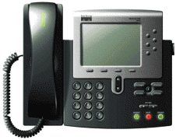

Sip Basic Call
SIP Server
SIP/SDP
SIP/SDP
Media (RTP)

Slide 11


Registration Operation
When I get a call for Alice, I’ll know to contact her at 192.168.0.1!
“I’m Alice, and I’ll be using a
phone at 192.168.0.1 today!”
192.168.0.1
SIP Server
sip.phonecompany.com
Ah, now I will have to use 10.0.1.1 to reach Alice.
“Lunch time! Use my mobile
at 10.0.1.1”
10.0.1.1

Slide 12

Proxy Operation
Bob is over at quickmart.com. I’ll proxy the call over there!
“I need to call Bob!”
sip.phonecompany.com
“Call here for
Bob from Alice”
“Call for you
from Alice!”
sip.quickmart.com

Slide 13
Redirection Operation
“I need to
call Bob!”
sip.phonecompany.com
“Call here for
Bob from Alice”
“Call here
for Bob
from Alice”
sip.diveapartment.com
“Try him at
diveapartment.com”
sip.quickmart.com
“Call for you
from Alice!”

Slide 14
SIP vs. H.323
Feature | H.323 | SIP
Encoding | Binary | Text
Control | Centralized server | Endpoints (using proxy)
Intelligence | Most in central server; core | Most in the endpoints; edge
Modularity | Monolithic (all in one server) | Can be multiple servers
Media | RTP | RTP

Slide 15
SIP Messages
Can either be Request or Response message
  Request: From Client to Server
  Response: From Server to Client
Can be passed:
  from user agent to user agent
  from SIP network server to user agent or vice versa
  from SIP network server to SIP network server
Each SIP Message contains:
  Request Line or Status Line
  Header
  Message (CPL, SDP, encrypted code, text or nothing)

Slide 16
Addressing
SIP-URL sip:user@host
    sip:Kathy_Baker@mitel.com
    sip:extension1640@mitel.com
    sip:Ramiro_Liscano@voicemail.mitel.com
Can accept parameters
    sip:Tom_Gray@cell.mitel.com&priority=urgent
    sip:Tom_Gray@mitel.com&subject=Bluetooth
Can be identified by generic URIs
    kanata.systems.mitel.com
    tel:13334442343

Slide 17
Request Message
Request Line
INVITE:sip:Daniel_Amyot@mitel.com SIP/2.0
From: Kathy <sip:Kathy_Baker@mitel.com>
To: Daniel <sip:Daniel_Amyot@mitel.com>
Contact: sip:Kathy_Baker@desktop.mitel.com
Call-ID: 20010110@kathy_phone.strat_tech
Content-Type: application/sdp
Content-Length: 147
CSeq: 1 INVITE
v=0
o=UserA 2890844526 2890844526 IN IP4 here.com
s=Session SDP
c=IN IP4 100.101.102.103
t=0 0
m=audio 49172 RTP/AVP 0
a=rtpmap:0 PCMU/8000
INVITE
ACK
OPTIONS
BYE
REGISTER
CANCEL
NOTIFY
SUBSCRIBE
REFER
MESSAGE
Message
Header
Message
Body
Notes:
43 possible headers

Slide 18
Response Message
Status Line
SIP/2.0 200 OK
Via: SIP/2.0/UDP kanata.mitel.com
From: Kathy <sip:Kathy_Baker@mitel.com>
To: Daniel <sip:Daniel_Amyot@mitel.com>
Call-ID: 20010110@kathy_phone.strat_tech
Contact: sip:Daniel_Amyot@desktop.mitel.com
CSeq: 1 INVITE
Status Codes
1xx Informational:
- Trying
- Ringing
- Being Forwarded
- Queued
200 Success
3xx Redirect
4xx Client Error
5xx Server Error
6xx Global Error
Message
Header
Message
Body
Notes:
43 possible headers

Slide 19
Request Methods
INVITE “Would you like to chat?”
ACK “Thanks, received your confirmation. Let’s start chatting”
BYE “Okay, I’m ending the call now.”
CANCEL “Cancel that last request but don’t end the call”
OPTIONS “What functionality do you support?”
REGISTER “Direct all my calls to this phone.”
Enables Mobility
Notes:
43 possible headers

Slide 20
Responses
Provisional (1xx class)
1xx = provisional, searching, ringing, queuing etc.
Final (2xx, 3xx, 4xx, 5xx, 6xx classes)
  2xx = success
  3xx = redirection, forwarding
  4xx = request failure (client mistakes)
  5xx = server failures
  6xx = global failure (busy, refusal, not available anywhere)
Notes:
43 possible headers

Slide 21
Generating Request
Valid SIP Request
  Request URI
  To
  From
  CSeq
  Call Id
  Via
  Max-Forwards

Slide 22
Reason
Fundamental Building Blocks of Request
Jointly Provide
  Message Addressing
  Critical Routing Services
  Limiting Message Propagation
  Ordering of Messages
  Unique identification of Transaction

Slide 23
Mandatory Headers
To
To: The Operator <sip:operator@cs.columbia.edu>;tag=287447
t: sip:+12125551212@server.phone2net.com
From
From: "A. G. Bell" <sip:agb@bell-telephone.com> ;tag=a48s
From: sip:+12125551212@server.phone2net.com;tag=887s
From: Anonymous <sip:c8oqz84zk7z@privacy.org>;tag=hyh8
Call-ID (uniquely identifies a particular invitation or all registrations)
Call-ID: f81d4fae-7dec-11d0-a765-00a0c91e6bf6@biloxi.com

Slide 24
Mandatory Headers
CSeq
CSeq: 4711 INVITE
Via
Via: SIP/2.0/UDP
erlang.bell-telephone.com:5060;branch=z9hG4bK87asdks7
Via: SIP/2.0/UDP 192.0.2.1:5060 ;received=192.0.2.207;branch=z9hG4bK77asjd
Max-Forwards
Max-Forwards: 6

Slide 25
Provisional Responses (Informational)
Informational
100 Trying
180 Ringing
181 Call forwarded
182 Queued
183 Session Progress
Notes:
43 possible headers

Slide 26
Final Responses
Success
200 OK
Redirection
300 Multiple Choices
301 Moved Perm.
302 Moved Temp.
380 Alternative Serv.
Notes:
43 possible headers

Slide 27
Final Responses
Request Failure
400 Bad Request 401 Unauthorized
403 Forbidden 404 Not Found
405 Bad Method 415 Unsupp. Content
420 Bad Extensions 486 Busy Here
Notes:
43 possible headers

Slide 28
Final Responses
Server Failure
500 Server Error
504 Timeout
503 Unavailable
501 Not Implemented
Global Failure
604 Doesn’t Exist
606 Not Acceptable
603 Decline
600 Busy Everywhere
Notes:
43 possible headers

Slide 29
Simple Call Flow
INVITE
180 RINGING
200 OK
ACK
Bi-directional Media between endpoints
BYE
200 OK
Notes:
43 possible headers

Slide 30
Call Flow with Proxy
SIP Server
INVITE
INVITE
100 Trying
180 Ringing
180 Ringing
200 OK
200 OK
ACK
Bi-directional Media between endpoints
BYE
BYE
200 OK
200 OK
Notes:
43 possible headers

Slide 31
INVITE Message
INVITE sip:bob@Atlanta.com SIP/2.0
Via: SIP/2.0/UDP pc33.Atlanta.com; branch=z9hG4bK776asdhds
Max-Forwards: 70
To: Bob <sip: bob@ Atlanta.com>
From: Alice <sip:alice@Atlanta.com>;tag=1928301774
Call-ID: a84b4c76e66710@pc33.Atlanta.com
CSeq: 314159 INVITE
Contact: <sip:alice@pc33.Atlanta.com>
Content-Type: application/sdp
Content-Length: 142
Notes:
43 possible headers

Slide 32
200 OK Message
SIP/2.0 200 OK
Via: SIP/2.0/UDP bigbox3.site3.atlanta.com
; Branch=z9hG4bK77ef4c2312983.1; received=192.0.2.2
Via: SIP/2.0/UDP pc33.atlanta.com;
branch=z9hG4bK776asdhds received=192.0.2.1
To: Bob <sip: bob@ Atlanta.com>; tag=a6c85cf
From: Alice <sip:alice@Atlanta.com>;tag=1928301774
Call-ID: a84b4c76e66710@pc33.Atlanta.com
CSeq: 314159 INVITE
Contact: <sip:bob@192.0.2.4>
Content-Type: application/sdp
Content-Length: 131
Notes:
43 possible headers

Slide 33



Stateless Proxy
cse.msu.edu
abc.com
INVITE
jshapiro@cse.msu.edu
jks@bahia
jshapiro?
alice@abc.com
INVITE
jks@bahia.cse.msu.edu
bahia
200 OK
jks@bahia.cse.msu.edu
ACK
jks@bahia.cse.msu.edu
Notes:
43 possible headers

Slide 34
Register Call Flow
SIP Server
REGISTER
401 Unauthorized
REGISTER
200 OK
Notes:
43 possible headers

Slide 35
Redirect Call Flow
iptel.org
abc.com
jks@bahia
jshapiro?
INVITE
jshapiro@iptel.org
alice@abc.com
302 Moved temporarily
contact jshapiro@bahia.cse.msu.edu
INVITE
jshapiro@cse.msu.edu
200 OK
jks@bahia.cse.msu.edu
cse.msu.edu
ACK
jks@bahia.cse.msu.edu
bahia
Notes:
43 possible headers

Slide 36
Message Call Flow
MESSAGE
200 OK
MESSAGE
200 OK
Notes:
43 possible headers

Slide 37
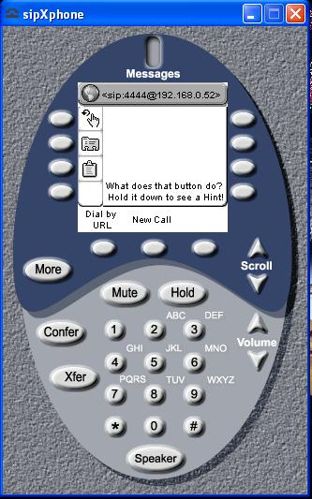
User Agent Examples

Slide 38
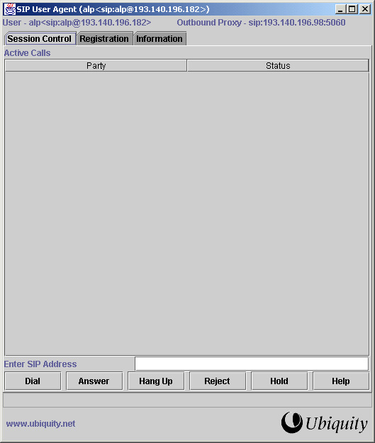

Slide 39
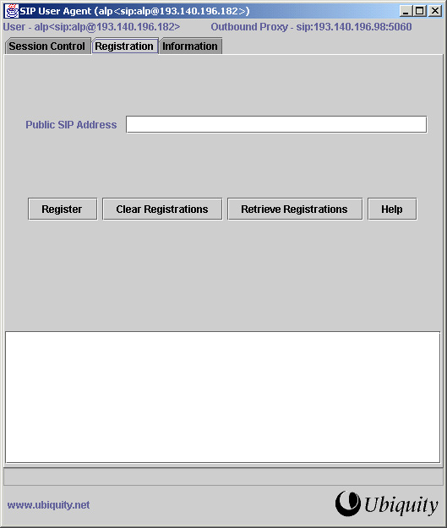

Slide 40
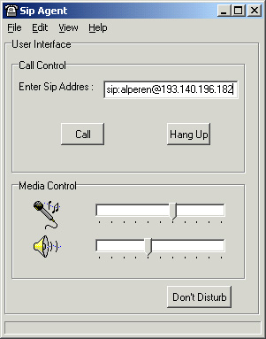

Slide 41
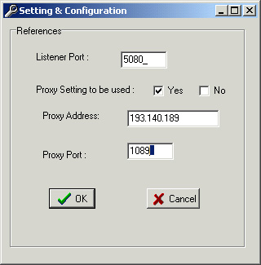
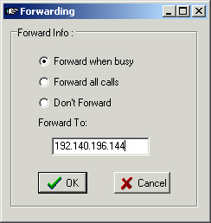

Slide 42
